Slide 2
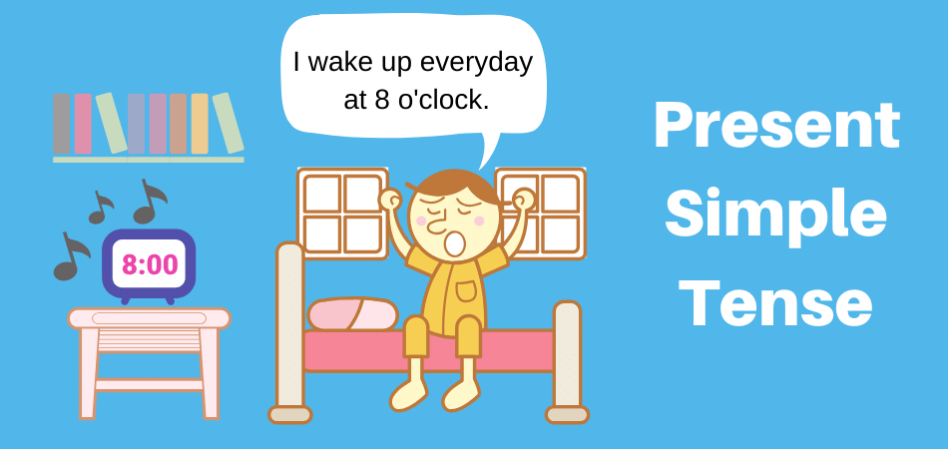
Unit
1
HOBBIES
LESSON 3: A CLOSER LOOK 2
Unit

Slide 3
LESSON 3: A CLOSER LOOK 2
WARM-UP
Guessing game
PRESENTATION
Grammar focus
Present simple tense: Review
Task 1: Match the sentences to the correct uses.
Task 2: Complete the sentences. use the present simple form of the verbs.
Task 3: Fill in each blank with the correct form of the verb in brackets.
Task 4: Write complete sentences, using the given words and phrases.
PRACTICE
PRODUCTION
Task 5: Game - Sentence race
CONSOLIDATION
Wrap-up
Homework

Slide 4
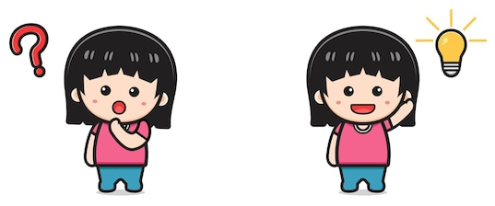
LESSON 3: A CLOSER LOOK 2
Review the previous lesson
Jumble Words
H r s e o R n i n g i d
→ Horse Riding

Slide 5
L u g e
GLUE
→ Hồ , keo

Slide 6
Dllo huoes
Doll house
→ Nhà búp bê

Slide 7
pustairs
Upstairs
→ Lên lầu

Slide 8
mazaing
Amazing
→ Ngạc nhiên

Slide 9
Scion
coins
→ Đồng xu

Slide 10
Mikang Meldos
Making models
→ Làm mô hình

Slide 11
ggingjo
Jogging
→ Đi/ chạy bộ

Slide 12
Expressing like/ dislike + sth
S like/ love/ enjoy + N
dislike/hate
I love gardening
She hates jogging

Slide 13
Review the vocabulary
Glue (n): hồ , keo dám
Doll house (n): nhà búp bê
Upstairs (n): lên lầu
Amazing (adj): làm sửng sốt, nhạc nhiên
Coins (n): đồng xu
Making models: làm mô hình
Jogging (n): đi/ chạy bộ thể dục
S+ like/ love/ enjoy + N
dislike/hate

Slide 14
LESSON 3: A CLOSER LOOK 2
PRESENTATION
Grammar focus
Present simple tense: Review

Slide 15
PRESENTATION
The present simple
→ Diễn tả 1 sự thật hiển nhiên
→ Diễn tả 1 điều diễn ra ở hiện tại
→ Diễn tả 1 lịch trình, chương trình,
hoặc thời gian biểu

Slide 16
PRESENTATION

Slide 17
PRACTICE
1
Match the sentences (1 – 5) to the correct uses (a – c).
b
a
c
a
b

Slide 18
PRACTICE
2
Complete the sentences. Use the present simple form of the verbs.
1. My brother and I (make) ________ a new model every month. 2. What _________ Lan (do) ________ in her free time? 3. I (have) _________ a drawing lesson every Tuesday. 4. Mark (not like) ____________ doing judo. 5. _________ your English lesson (start) _________ at 6 p.m.?
make
does
do
have
doesn’t like
Does
start

Slide 19
PRACTICE
3
Fill in each blank with the correct form of the verb in brackets.
My family members have different hobbies. My dad (1. enjoy) _________ gardening. He (2. spend) __________ two hours in our garden every day. My mum and sister (3. not like) __________ gardening, but they love cooking. They (4. go) _______ to a cooking class every Sunday. Their lesson (5. begin) ________ at 9 a.m. I (6. not enjoy) _______________ cooking, and I cannot cook very well.
enjoys
spends
don’t like
go
begins
don’t enjoy

Slide 20
PRACTICE
4
Write complete sentences, using the given words and phrases. You may have to change the words or add some.
1. sun / set / in / west / every evening. __________________________________________________________ 2. Trang and Minh / play / basketball / every day / after school? __________________________________________________________ 3. flight / from / Ho Chi minh City / not arrive / 10:30. __________________________________________________________ 4. our science teacher / start / our lessons / 1 p.m. / on Fridays. __________________________________________________________ 5. you / make / model / at / weekend? __________________________________________________________
The sun sets in the west every evening.
Do Trang and Minh play basketball every day after school?
The flight from Ho Chi Minh City doesn’t arrive at 10:30.
Our science teacher starts our lessons at 1 p.m. on Fridays.
Do you make models at the weekend?

Slide 21
PRODUCTION
5
Game: Sentence Race

Slide 22
CONSOLIDATION
1
WRAP-UP

Slide 23
CONSOLIDATION
2
HOMEWORK
Complete exercises in the Workbook.

Slide 24
Website: sachmem.vn
Fanpage: facebook.com/sachmem.vn/

Slide 26
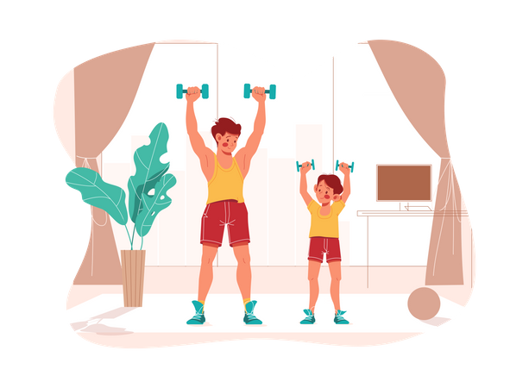
Unit
1
HOBBIES
LESSON 4: COMMUNICATION
Unit
HOBBIES

Slide 27
LESSON 4: COMMUNICATION
WARM-UP
Arranging verbs of liking in the descending order of preference
Verbs of liking
Task 1: Listen and read the dialogue below. Pay attention to the questions and answers.
Task 2: Work in pairs. ask and answer questions about what you like and don’t like doing.
EVERYDAY ENGLISH
Task 3: Answer the questions. Fill in column A with your answers.
Task 4: Now interview your friend. Write his / her answers in column B.
Task 5: Compare your answers with your friend’s. Then present them to the class.
ALL ABOUT
YOUR HOBBIES
CONSOLIDATION
Wrap-up
Homework

Slide 28
WARM-UP
Arrange the following verbs of liking in descending order of preference.
like
adore
hate
dislike
love
detest

Slide 29
WARM-UP
Arrange the following verbs of liking in descending order of preference.
adore
love
like
dislike
hate
detest

Slide 30
EVERYDAY ENGLISH
VERBS OF LIKING + V-ING
We often use the –ing form after verbs of liking and disliking.
S + like/ love/ enjoy/ adore + V-ing
dislike/ hate/ detest
→ Cấu trúc diễn tả sự yêu thích/ không thích làm gì đó (Sử dụng V–ing)
Example: I like going to the cinema.
She hates cleaning the floors.

Slide 31
EVERYDAY ENGLISH
1
Listen and read the dialogue below. Pay attention to the questions and answers.
Mi: Do you like reading books? Ann: Yes, very much, especially books about science. Mi: What about painting? Do you like it? Ann: No, I don’t. I’m not interested in art.

Slide 32
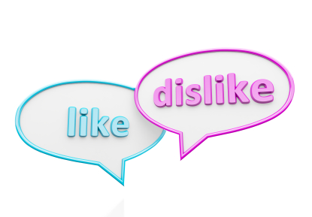
EVERYDAY ENGLISH
2
Work in pairs. Ask and answer questions about what you like and don’t like doing.
A: Do you like/ love/ enjoy/ adore + V-ing?
dislike/ hate/ detest
B: Yes, I do. ...
No. I don’t. I love ...
Reading books - listening to music - playing sports - hanging out, gardening - making models - building dollhouses - doing yoga, doing judo - collecting coins/ teddy bears

Slide 33
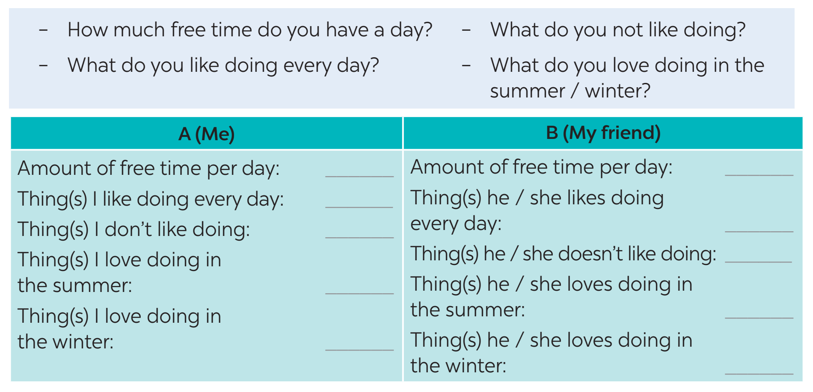
ALL ABOUT YOUR HOBBIES
3
Answer the questions. Fill in column A with your answers.
3 hours
Reading books
Doing judo
Going camping
Doing jogging

Slide 34
ALL ABOUT YOUR HOBBIES
4
Now interview your friend, using the questions in Task 3. Write his / her answers in column B.

Slide 35
PRODUCTION
5
Compare your answers with your friend’s. Then present them to the class.
Example: I have one hour of free time a day, but my friend Lan has only about 30 minutes. I like listening to music every day, and Lan likes it too. I don’t like exercising, but Lan does.

Slide 36
CONSOLIDATION
1
WRAP-UP
In this lesson, we have learn to:
use the lexical items related to the topic Hobbies
describe and give opinions about hobbies

Slide 37
CONSOLIDATION
2
HOMEWORK
use the lexical items related to the topic Hobbies
talk about likes and dislikes
ask and answer about hobbies

Slide 38
Website: sachmem.vn
Fanpage: facebook.com/sachmem.vn/

